Slide 1
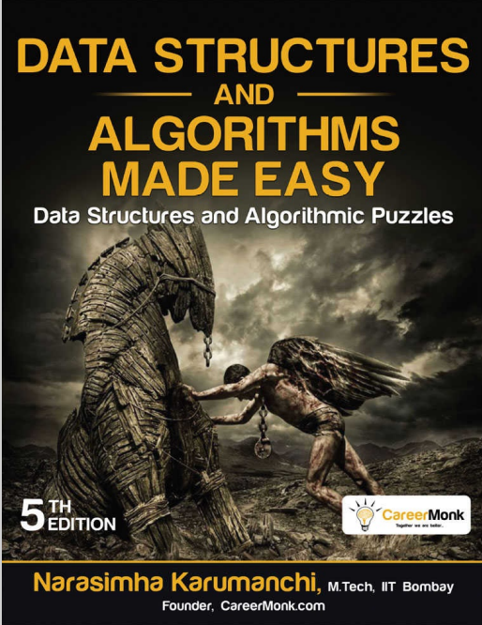
Programming
Chapter 1
Introduction to algorithm

Slide 2
Course introduction
This unit introduces students to the core concepts of programming with an introduction to algorithms and the characteristics of programming paradigms
On successful completion of this unit students will be able to design and implement a simple computer program in a chosen language (C#) within a suitable IDE (Visual Studio .NET)

Slide 3
Learning outcomes
LO1: Define basic algorithms to carry out an operation and outline the process of programming an application.
LO2: Explain the characteristics of procedural, object-orientated and event-driven programming, conduct an analysis of a suitable Integrated Development Environment (IDE)
LO3: Implement basic algorithms in code using an IDE.
LO4: Determine the debugging process and explain the importance of a coding standard

Slide 4
Course materials
Login to CMS (http://cms.btec.edu.vn/) with student account (name@fpt.edu.vn)
Choose correct class
Enroll by class name (GCH0x0x)
CMS Folder:
Slides
Demo
Assignment 1
Assignment 2

Slide 5
Course preparation
Drawing tools (choose one):
Visio
Draw.io or Lucichart (online)
Astah (recommendation, using student email to register full version)
IDE
Visual Studio Community 2022

Slide 6
Course reading
Slides on CMS
C# 6.0 and .NET Framework 4.6
http://library.books24x7.com/toc.aspx?bookid=104367
Registered with student email
Mohammad Rahman, Expert C#5.0 with .NET 4.5 Framework

Slide 7
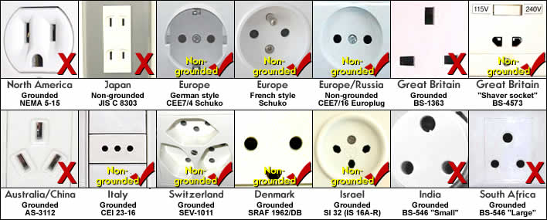




Problem solving
It’s a creative process, it is an act of
Defining a problem
Determining the cause of the problem
Identifying, prioritizing, and selecting alternative for a solution
Implementing a solution

Slide 8
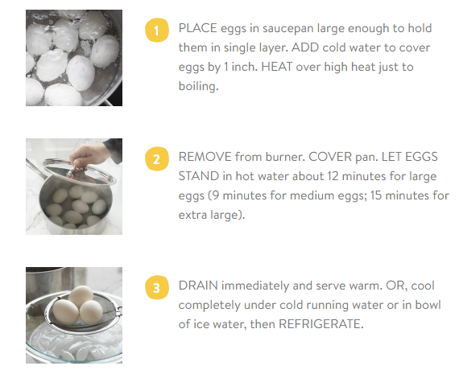
Algorithm
An algorithm is the step-by-step unambiguous instructions to solve a given problem.
In the traditional study of algorithms, there are two main criteria for judging the merits of algorithms: correctness (does the algorithm give solution to the problem in a finite number of steps?) and efficiency (how much resources (in terms of memory and time) does it take to execute.
http://www. incredibleegg.org
Notes:
G/v giải thích các tính chất của thuật toán (definite, finite, precise & effective, independent) qua ví dụ luộc trứng

Slide 9
Computers and Algorithms
To make a computer do anything, we have to write a computer program.
To write a computer program, we have to tell the computer, step by step, what we want it to do.
The computer then "executes" the program, following each step mechanically, to accomplish the desired goal.
Data structure + algorithms = program

Slide 10
Computers and Algorithms
When we are telling the computer what to do, we also get to choose how it's going to do it.
That's where computer Algorithms come in to picture.
The algorithm is the basic technique used to get the job/work done.
When we say that algorithms are ubiquitous, we mean… Algorithms are found everywhere. Algorithms can be used to solve many different types of problems. Algorithms are a daily occurrence.

Slide 11
Algorithms Characteristics
Finiteness: An algorithm must always terminate after a finite number of steps.
Definiteness: Each step of an algorithm must be precisely defined; the actions to be carried out must be rigorously and unambiguously specified for each case.
Input: An algorithm has zero or more inputs
Output: An algorithm has one or more outputs
Effectiveness: the algorithms is based on the available resources. It should be effective, exact and suitable for programs.
Language Independent: The Algorithm designed must be language-independent. It has to be general resources. We can apply to all programming languages.
Notes:
Finiteness
Definiteness

Slide 12
Types of algorithms
Sequence: this type of algorithm is characterized with a series of steps, and each step will be executed one after another.
Branching: this type of algorithm is represented by the "if-then" problems. If a condition is true, the output will be A, if the condition is false, the output will be B. This algorithm type is also known as "selection type".
Loop: for this type, the process might be repeatedly executed under a certain condition. It is represented by "while" and "for" problems. But make sure the process will end after a number of loops under the condition. This algorithm type is also known as "repetition type".

Slide 13
Algorithm representation
Natural language
Flowchart
Pseudo code

Slide 14
Natural language
List sequentially the steps in natural language to represent the algorithm
Advantages: Simple, no knowledge of representation (pseudocode, flowchart,...)
Disadvangtages: Long, unstructured. Sometimes it's hard to understand, can't express the algorithm

Slide 15
Flowchart
Flowchart is a diagrammatic representation of an algorithm
It uses different symbols to represent the sequence of operations, required to solve a problem
It serves as a blueprint or a logical diagram of the solution to a problem

Slide 16
Flowchart
The first design of flowchart goes back to 1945 which was designed by John Von Neumann.
Unlike algorithm, Flowchart uses different symbol to design a solution to a problem
It is another commonly used programming tool. By looking at a flowchart one can understand the operations and sequence of operations performed in a system.
Flowchart is often considered as a blueprint of a design used for solving a specific problem

Slide 17
Advantages of flowchart
Flowchart is excellent way of communicating the logic of a program.
Easy and efficient to analyze problem using flowchart.
During program development cycle, the flowchart plays the role of a blueprint, which makes program development process easier.
After successful development of a program, it needs continuous timely maintenance during the course of its operation. The flowchart makes program or system maintenance easier.
It is easy to convert the flowchart into any programming language code.

Slide 18
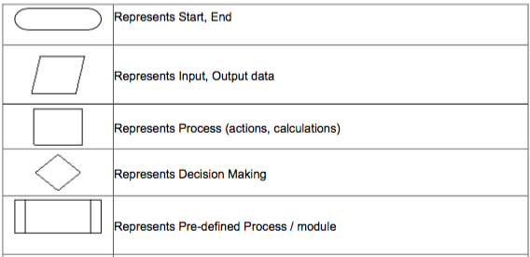
Flowchart symbols (1/2)

Slide 19
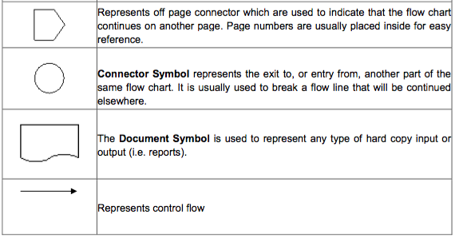
Flowchart symbols (2/2)
Notes:
Nhớ : ký hiệu Bắt đầu, kết thúc , đầu vào, đầu ra, xử lý, quyết định , luồng chương trình (đường mũi tên)
Can use https://www.draw.io to draw

Slide 20
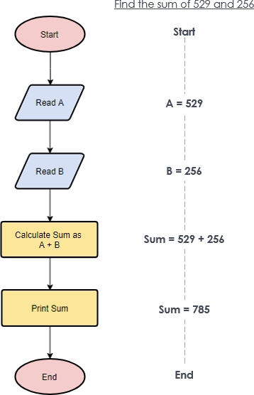
Some control structure
Sequence

Slide 21
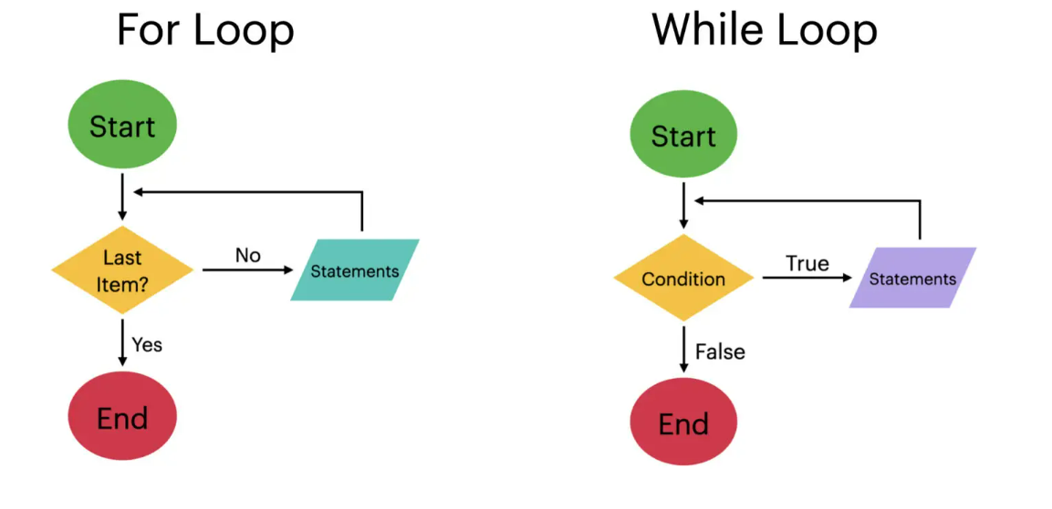
Some control structure
Loop

Slide 22
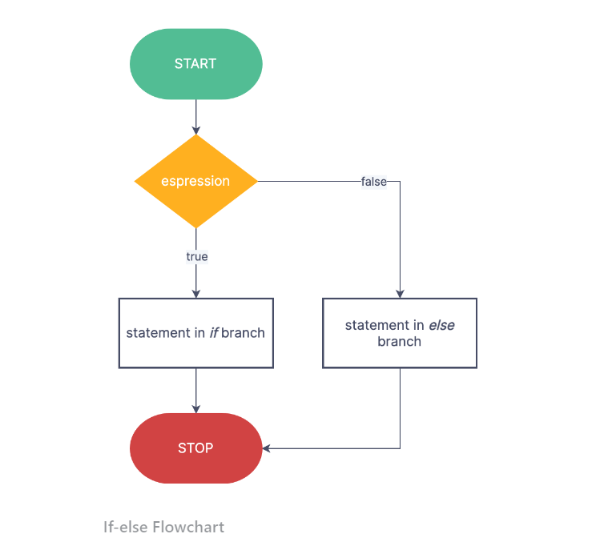
Some control structure
Selecting

Slide 23
Activity 1
Ask students to consider everyday tasks with a sequence of steps (for example, preparing to play a game using PlayStation, making a sandwich, fixing a puncture on a bicycle tyre, making a cake).
Ask students to suggest a sequence of steps for cleaning teeth. Remind them to sequence the steps in a logical order.

Slide 24
Activity 2
Give the class a list of algorithms in Math
EX: Algorithm for addition:
Step 1: Line up the numbers vertically by matching the place values.
Step 2: Add together the numbers that share the same place value, starting with the ones column.
Step 3: Write the sum below each column.
Step 4: If the sum of a column is greater than 9, carry over the tens digit to the next column.

Slide 25
Pseudo code
Pseudo code is basically short English phrases used to explain specific tasks within a program’s algorithm. It should not contain any specific computer languages.
If you can not write it in Pseudo code you won’t be able to write it in C++ or Java
Notes:
ax+b = 0 ,
Nếu a = 0 , b= 0 thì pt có vô số nghiệm
Nếu a = 0, b khác 0 thì pt vô nghiệm
Nếu a khác 0, phương trình có nghiệm x = -b/a
If (a =0) then ( if (b =0) in ra vô số nghiệm )

Slide 26
Pseudo code
IF <condition> THEN …ENDIF
IF <condition> THEN ... ELSE ... ENDIF
WHILE <condition> DO … ENDWHILE
DO … UNTIL <condition>
DISPLAY …
RETURN
Notes:
ax+b = 0 ,
Nếu a = 0 , b= 0 thì pt có vô số nghiệm
Nếu a = 0, b khác 0 thì pt vô nghiệm
Nếu a khác 0, phương trình có nghiệm x = -b/a
If (a =0) then ( if (b =0) in ra vô số nghiệm )

Slide 27
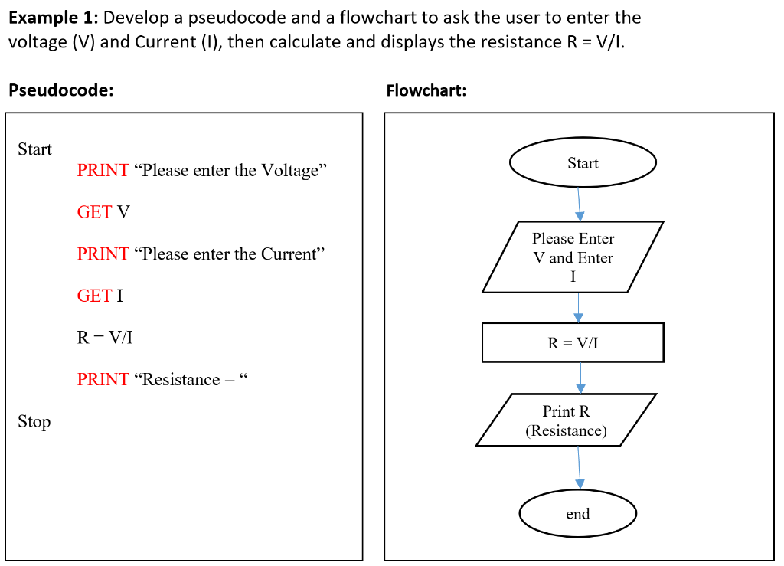
Pseudo code

Slide 28
Algorithm Analysis
To compare algorithms, let us define a few objective measures:
Execution times? Not a good measure as execution times are specific to a particular computer.
Number of statements executed? Not a good measure, since the number of statements varies with the programming language as well as the style of the individual programmer.
Ideal solution? Let us assume that we express the running time of a given algorithm as a function of the input size n (i.e., f(n)) and compare these different functions corresponding to running times. This kind of comparison is independent of machine time, programming style, etc.

Slide 29
Algorithmic Performance
There are two aspects of algorithmic performance:
Time
Instructions take time.
How fast does the algorithm perform?
What affects its runtime?
Space
Data structures take space
What kind of data structures can be used?
How does choice of data structure affect the runtime?
We will focus on time:
How to estimate the time required for an algorithm
How to reduce the time required

Slide 30
Summary
Draw a mind-map to summarize the content of this lecture

